Slide 1
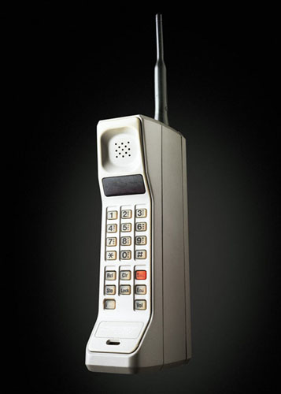
First Cell Phone By: Bisrat Bisrat

Slide 2
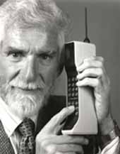
Creator
Martin Cooper worked for Motorola created the first cell phone in 1973.
He worked at Motorola for 29 years.

Slide 3
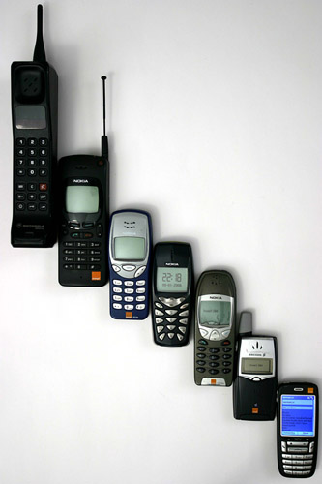
Facts and Evolution
Cost $8,700 in today’s money.
Weight of 2.5 lbs, 10 inches in length, with 20 minute talk time.
First call Cooper made was to Joel Engel his biggest rival.
One short call for Cooper, one giant leap forward for mankind.

